Slide 1
NVRAM research
최원기

Slide 2
Index
What is NVRAM?
NVRAM researches
P-SQLITE:PRAM-Based Mobile DBMS for Write Performance Enhancement
(FUTURE COMPUTING 2013)
SQLite Optimization with Phase Change Memory for Mobile Application
(VLDB 2015)
NVWAL: Exploiting NVRAM in Write-Ahead Logging
(ASPLOS 2016)
PCMLogging:Optimizing Transaction Logging and Recovery Performance with PCM
(TKDE 2015)

Slide 3
What is NVRAM
Non-Volatile RAM
ex) Phase Change Memory
C. A.
CPU
NVRAM
Memory layer
DRAM
?
Storage layer
HDD
SSD

Slide 4
Characteristics of NVRAM
Low Latency as DRAM
Disparity of read/write latency
Byte-addressable
Non-Volatile, Persistent
Endurance limit

Slide 5
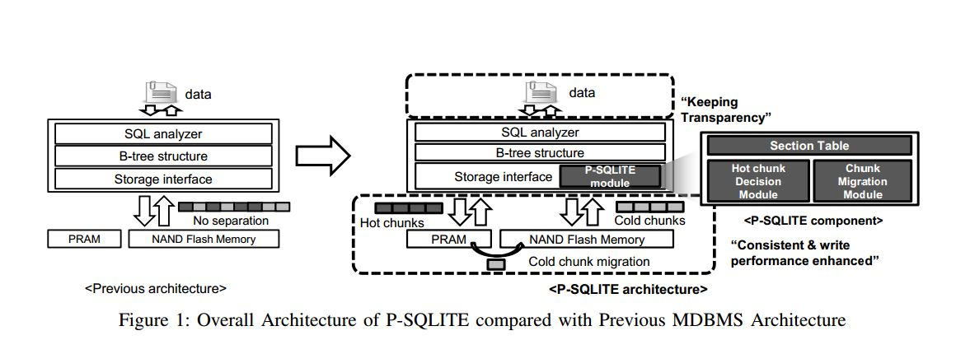
Naïve method
(1) P-SQLITE:PRAM-Based Mobile DBMS for Write Performance Enhancement
Use PCM as Cache Layer : Hot Data -> PCM , Cold Data -> SSD

Slide 6
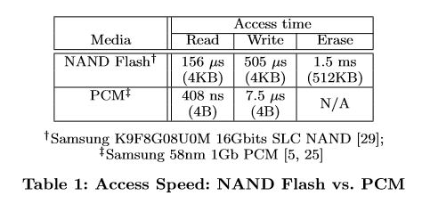
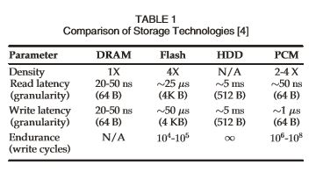
However,
PCM is not appropriate for Block Access !!
DATA
DATA
DATA
DATA
DATA
DATA
DATA
Byte-addressable
Block-addressable

Slide 7
Therefore
Focus on storing small data utilizing PCM
Especially, Log, Write-Ahead Log
DB
Crash
page1
page2
5
6
1
2
88
6
5
7
8
3
4
7
8
Log
page3
original
Insert 5
9
10
88
6
11
12
7
8

Slide 8
In SQLite,
Write Amplification
SQLite Journaling mode (Delete and WAL)
Delete mode (Rollback journal)
WAL mode (Write-Ahead Logging)
Insert data
Insert data
DB file
DB file
copy
2 write
WAL file
DB file
journal file
DB file
2 write
DB file
journal file
DB file
WAL file
checkpoint

Slide 9
(2) SQLite Optimization with Phase Change Memory for Mobile Application
Applying Per-Page logging
About transaction
begin commit abort
Also it is called transaction log
DRAM
read
PRAM
page
page
page
+
Physiological log
Global log
write
Physiological log
Global log
+
Physiological log
Physiological log < 32byte
Flash Storage
TxID | Log Type | Length | Offset | CRC | After Image
page
page
TxID : ID of write transaction
Log Type : insert, delete, update, begin_transaction, commit, abort
Length, Offset : represent location of changes
CRC : checksum for log
After Image : value of changes
header
Sqlite page structure
cell pointer
data

Slide 10
SQLite/PPL(cont’d)
Applying Per-Page logging
When update in Page 3
DRAM
PRAM
Page 1
Page 2
Page 3
Log
Sector
(4k)
Global log
Allocate
Against page 3
Cell 1
Cell 2
When full
Cell 3
Flash Storage
Page 2
Page 3
Log 3
Check whenever transaction is committed
Log 2
Log 1

Slide 11
SQLite/PPL(cont’d)
Applying Per-Page logging
When update in Page 3
DRAM
PRAM
Page 1
Page 2
Page 3
Log
Sector
(4k)
Global log
Allocate
Against page 3
Cell 1
Cell 2
Cell 3
Flash Storage
Page 2
Page 3
Page 3
Find committed log
full
Log 3
Log 2
Log 1
Page 3
Log 1
Page 3
+
Log 2
=
...

Slide 12
SQLite/PPL(cont’d)
Applying Per-Page logging
When read Page 1
Page fault
DRAM
PRAM
Page 1
Page 2
Page 3
Log
Sector
(4k)
Global log
Allocated
Against page 1
Flash Storage
Cell 1
Cell 2
Cell 3
Page 1
Page 2
Page 3
Find committed log
Log 3
Log 2
Log 1
Page 1
Log 1
Page 1
+
Log 2
=
...

Slide 13
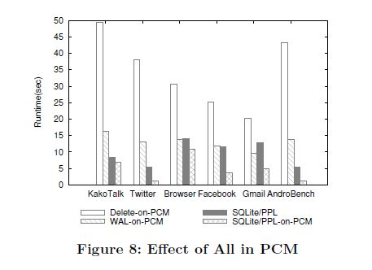
Evaluation(cont’d)

Slide 14
(3) NVWAL: Exploiting NVRAM in Write-Ahead Logging
Paper’s contribution
Byte-granularity differential logging
Transaction-aware memory persistency guarantee
User-level NVRAM management for WAL
Effect of NVRAM latency on application performance

Slide 15
(3) NVWAL: Exploiting NVRAM in Write-Ahead Logging
commit
NVWAL
DRAM
checkpoint
NVRAM
Storage

Slide 16
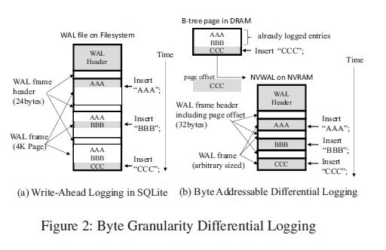
Byte-Granularity Differential Logging

Slide 17
User-Level NVRAM Heap Management(1)
Without User-level management
DRAM buffer
User-level
kernel-level
nv_malloc() overhead x 3
NVRAM

Slide 18
User-Level NVRAM Heap Management(2)
u: in-use
p: pending
f: free
Kernel space
u
f
f
f
meta
meta
Contain Permission, status of block
WAL Header
User space
WAL frame header
WAL frame (page 2)
Block size : 8kb
Contain commit flag, checkpointing id number, database page number, in-page offset, frame size, checksum bytes for WAL frame
WAL frame header
WAL frame (page 7)
next

Slide 19
User-Level NVRAM Heap Management(2)
u: in-use
p: pending
f: free
Kernel space
p
f
u
f
u
f
meta
meta
commit
WAL Header
nv_pre_malloc()
User space
WAL frame header
WAL frame (page 2)
nv_malloc_set_used_flag
WAL frame header
WAL frame (page 7)
next

Slide 20
User-Level NVRAM Heap Management(2)
u: in-use
p: pending
f: free
Kernel space
u
u
f
f
meta
meta
WAL Header
WAL frame header
User space
WAL frame (page 2)
WAL frame header
WAL frame header
WAL frame (page 2)
WAL frame (page 7)
WAL frame header
WAL frame (page 3)
WAL frame header
WAL frame (page 7)
next

Slide 21
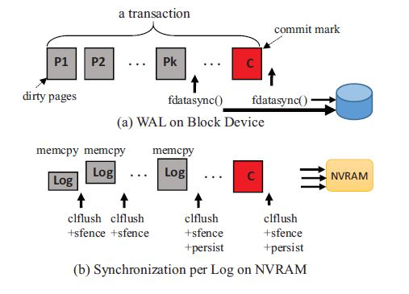
Transaction-aware memory persistency guarantee
(a) explain WAL process on Block Device(SSD)
(b) explain Logging Process on NVRAM.
To gain durability of transaction, Log prevent reordering of memory write operation using memory barrier and clflush operation
clflush : cache line flush operation
sfense : memory barrier
persist barrier : cache lines queued in the memory subsystem are persisted to NVRAM

Slide 22
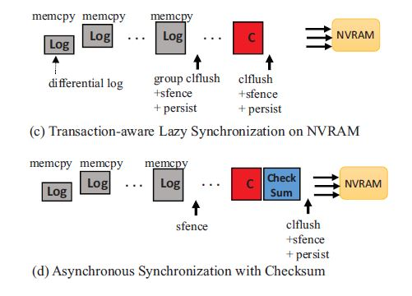
Transaction-aware memory persistency guarantee
(c) SQLite is a serverless DBMS (one write transaction).
Write transaction requires an exclusive lock on the entire database file.
NVWAL allows processors to flush the WAL frames to NVRAM in any order.
(d) Compromising the consistency using checksum bytes.
Do not enforce barrier between logging phase and commit phase.
Commit and Checksum can be written to NVRAM before logs are written completely.
System crash may corrupt a database file.
clflush : cache line flush operation
sfense : memory barrier
persist barrier : cache lines queued in the memory subsystem are persisted to NVRAM

Slide 23
Checkpoint and Recovery
Checkpoint
Reconstruct the dirty pages
by combining the log entries and respective original database pages
All dirty pages are flushed to DB file via fsync()
NVRAM blocks are truncated from the end of the list to the beginning. (setting flag to free, then call nvfree() system call)
Recovery
Replay log referring to reconstructed dirty pages from byte addressable WAL frame.

Slide 24
Recovery in Meta-block(1)
In-use
pending
WAL Header
crash
unused
WAL frame header
WAL frame (page 2)
WAL frame header
WAL frame (page 7)
next

Slide 25
Recovery in Meta-block(1)
In-use
pending
free
WAL Header
unused
WAL frame header
WAL frame (page 2)
WAL frame header
WAL frame (page 7)
next

Slide 26
Up to 84% of I/O reduced

Slide 27
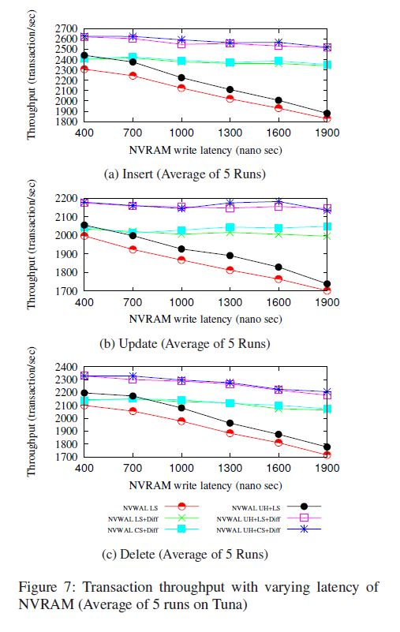
6%
28%
37%
User-Level Heap improves 6% of performance
Differential logging yields up to 28% higher throughput
In Total, 37% higher performance

Slide 28
(4) PCMLogging:Optimizing Transaction Logging and Recovery Performance with PCM
Key Idea
Intergrating Data and Log with out-place update
to boost efficiency of usage of storage and performance
The unit of Data or Log is record not page
+ wear leveling, destaging algorithm

Slide 29
(4) PCMLogging:Optimizing Transaction Logging and Recovery Performance with PCM
C. A.
CPU
NVRAM
Commit or flush
Memory layer
DRAM
NVRAM
Storage layer
HDD
SSD

Slide 30
Key structure
Data Structure
Mapping Table -> map logical page ID to physical PCM address
FreeSlotBitMap -> keep track of the free page slots in PCM
Transaction Table -> all in-progress transactions is recorded
Dirty Page Table -> keep track of the previously committed page
ActiveTxList -> all in-progress transactions which has PCM pages is recorded
PCM Record Type
PID+SNO = Record ID
Record is managed in table with slots in pages

Slide 31
Example
Flushing dirty page to PCM
Commit
Abort
Recovery

Slide 32
Example cont(1)
Flushing dirty page to PCM (suppose T3 update P5-R2)
PCM
P5-R2 | M7
(M1) | (M2) | (M3) | (M4)
(M5) | (M6) | (M7) | (M8)
T1 | M1,M2,M3
T3 | P5-R2
PCM slot
Mapping Table
Transaction Table
Dirty Page Table
1 | 1 | 1 | 0 | 1 | 0 | 1 | 0
Memory
FreeSlotBitMap
Record 1
Record 2
T1
Record 3
ActiveTxList

Slide 33
Example cont(2)
Flushing dirty page to PCM
PCM
P5-R2 | M7
(M1) | (M2) | (M3) | (M4)
(M5) | (M6) | (M7) | (M8)
M8
T1 | M1,M2,M3
T3 | P5-R2
M8
M7
M8
Check TT
PCM slot
Mapping Table
Transaction Table
Dirty Page Table
1
1 | 1 | 1 | 0 | 1 | 0 | 1 | 0
Memory
FreeSlotBitMap
Add ActiveTxList
T1
T3
ActiveTxList

Slide 34
Example cont(3)
Commit
PCM
P5-R2 | M7
(M1) | (M2) | (M3) | (M4)
(M5) | (M6) | (M7) | (M8)
M8
T1 | M1,M2,M3
T3 | P5-R2
M8
M7
M8
Remove previous version
PCM slot
Mapping Table
Transaction Table
Dirty Page Table
0
1 | 1 | 1 | 0 | 1 | 0 | 1 | 1
Memory
FreeSlotBitMap
T1
T3
Remove from list
ActiveTxList

Slide 35
Example cont(2)
Abort
PCM
P5-R2 | M7
(M1) | (M2) | (M3) | (M4)
(M5) | (M6) | (M7) | (M8)
M8
T1 | M1,M2,M3
T3 | P5-R2
M8
M7
M7
M8
PCM slot
FreeSlot 1->0
Mapping Table
Transaction Table
Dirty Page Table
1
1 | 1 | 1 | 0 | 1 | 0 | 1 | 0
Memory
FreeSlotBitMap
T1
T3
ActiveTxList

Slide 36
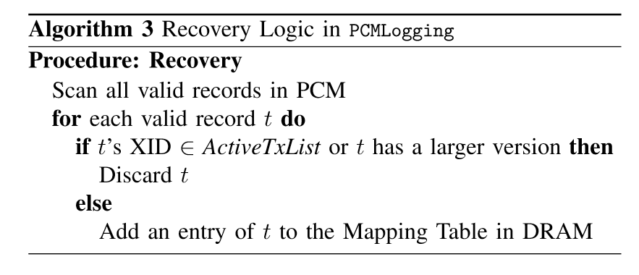
Recovery

Slide 37
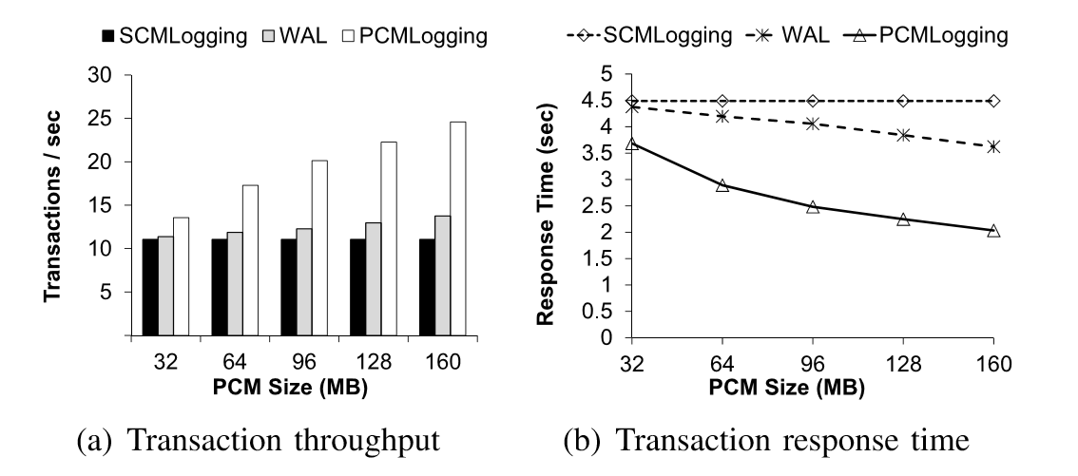
Overall Performance

Slide 38
Conclusion
Usage of NVRAM
Utilize Byte-addressable feature( Not Block Device)
Consider Endurance limit
How to use NVRAM
Cache?
Or All NVRAM store

Slide 39
END of Presentation

