Slide 1
Failure-Atomic Slotted Paging
for Persistent Memory
ASPLOS’ 17
Jihwan Lee

Slide 2
1. Introduction
2. Background
3. Contribution
4. Implementation
5. Experiments
Failure-Atomic Slotted Paging
Contents

Slide 3
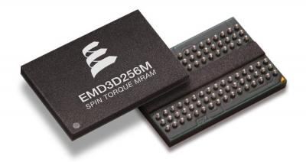
1
Introduction
Paper?
Slot Header
Record Content Area Area
1
Free space
Database page format
Variable-length record에 적합한Slotted paging 기법을 활용
Free space
Failure-Atomic Slotted Paging
for Persistent Memory
Recovery
Failure가 일어나도
Consistency 유지
(이전과 같은 상태를 유지)
Non-volatile memory
데이터를 지속 가능한 메모리 사용
(Journaling, WAL logging 부하↓)

Slide 4
2
Background
Persistent Memory
 | NAND | STT-MRAM | PCM | DRAM
Non-volatility | o | o | o | x
Read (ns) | 2.5 X 10⁴ | 5 - 30 | 20 – 70 | 10
Write (ns) | 2 X 10⁵ | 10 - 100 | 150 - 220 | 10
Byte-addressable | x | o | o | o
Non-volatile memory
Durability
Performance
Byte-addressable
➔ Be expected to replace DRAM & Flash memory
Traditional database management system
Considering PM as main memory
Volatile memory
buffer cache
Block device storage
Non-volatile memory
buffer cache
Block device storage
DB file
WAL logging
WAL
?

Slide 5
2
Background
Slotted page structure
: variable-length records in a fixed-sized block
…
Slot header
Free space
Record content area

Slide 6
2
Background
Transactional memory?
: 복수 개의 메모리 쓰기/읽기를 한 트랜잭션으로 묶어 마치 하나의 명령처럼 보이게 함
프로그래머가 직접 코드에 트랜잭션임을 명시함
→ 멀티스레드 환경에서 데드락이 없는 프로그램을 쉽게 만들 수 있도록 함
void swap (int &x, int &y) {
__ transaction
{
int tmp = x;
x = y;
y = tmp;
}
}
Restricted Transactional Memory (RTM)
- Intel의 Hardware Transactional Memory(HTM) 구현물
- New x86 instruction : XBEGIN, XEND, XABORT
- 단, TM 성공을 보장하지 않음 → 실패 시 fallback
Notes:
Restricted Transactional Memory
x86 명령어

Slide 7
3
Contribution
What?
Persistent Memory & Slotted paging
Where?
Database buffer cache (SQLite / B-tree) → Target to mobile application
How?
Single page - Failure-Atomic slotted paging (+ HTM)
Multiple page - Slot header logging
Why? (Purpose)
: Optimization of PM-only database buffer cache
vs. Hybrid memory systems with PM and DRAM (NVWAL - ASPLOS’ 16)
Durability, Byte-addressable (Persistent Memory)
Recovery (In-place commit + Logging, Failure-Atomic, Consistency)
Performance (Write overhead ↓)
➔ Hardware supporting(PM, HTM) + Optimal idea = This paper !

Slide 8
4
Implementation
Failure-Atomic Slotted Paging
: In-place commit with hardware transactional memory
Slot header가 commit mark처럼 사용됨
Slot header에 쓰이지 않았기 때문에 record는 Invisible
Slot Header
Slot Header
2)
Slot Header
1)
Record Content Area
Record Content Area
visible
Record Content Area
invisible
800
1000
Free space
Key = 20
Free space
3
900
1000
Free space
Key = 10
Key = 30
1000
Free space
Free space
Free space
Key = 20
Key = 10
Key = 10
Key = 30
2
Key = 30
2
900
900
900 1000
900 1000
800
900 1000
800
* Insertion
1) Writing the record into the record content area
2) Atomically writing the record offset to the slot header and increasing the number of records

Slide 9
4
Implementation
Failure-Atomic Slotted Paging
Atomically ?
→ Hardware Transactional Memory(HTM)
Persistent Memory
Dirty Record of Slotted Page
DB Buffer Cache
Slot Header
* 가정 :
Cache line size > Slot header size
Write combining store buffer
Insert
XBEGIN
Slot header
XEND
 |  | 3
CLWBs/
MFENCE
CLWB/
MFENCE

Slide 10
4
Implementation
Failure-Atomic Slotted Paging
* Update
1) Adding an updated record in free space
2) Atomically replacing the offset of the previous record so that the previous record is marked as deleted
Fragmentation 발생
Slot Header
Record Content Area
800
1000
Free space
Key = 10
2
900
Free space
Key = 10
Key = 30
800
900 1000
* Deletion
1) Atomically invalidating the record by deleting its offset from the record offset array and decreasing the number of records
Slot Header
Record Content Area
1
1000
Free space
Key = 10
Key = 30
2
900
1000
900 1000

Slide 11
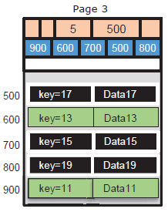
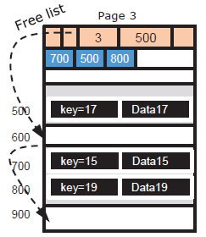
4
Implementation
Failure-Atomic Slotted Paging
* Fragmentation 대처
1) Linked list (free list) 사용
2) Defragmentation : 또 다른 Slotted page을 Copy-on-Write으로 할당
➔ 실제 B-tree insertion time이 약 0.02% 미만 증가 (큰 영향을 주지 않는 정도로 수행)

Slide 12
4
Implementation
Slot header logging
Failure-Atomic slotted page → In-place commit
문제점
1) Update multiple pages
2) Insert new record into slotted page and split a page
→ 다수의 page를 사용할 경우 다수의 Cache line 사용이 필요(Granularity) → 이를 Atomic 하게 처리 불가
* Example in system failure : Move data with key 20 from page A to page B
Page A
2
900
1000
Free space
Key = 20
Key = 10
Key = 30
800 900 1000
invisible
Page B
2
1000
900
Free space
Key = 20
Key = 50
Key = 40
900 1000
invisible

Slide 13
4
Implementation
Slot header logging
따라서 Logging을 통해 Recovery 시에도 Consistency를 유지 해야 함.
Logging으로 부터 발생하는 Write Overhead가 크므로, Metadata 정보만 갖는 Slot header만 Logging
➔ Slot header logging

Slide 14
4
Implementation
Slot header logging
<Logging>
Persistent (PM) Buffer Cache
A
 |  | 3 |  |  |  |  |  |  |  |  |  | 20 | 10 | 30
B
 |  | 2 |  |  |  |  |  |  |  |  |  | 20 | 50 | 40
dirty record
Slot Header Log
A
 |  | 2
B
 |  | 3
commit

Slide 15
4
Implementation
Slot header logging
<Checkpointing>
Persistent (PM) Buffer Cache
 |  | 3 |  |  |  |  |  |  |  |  |  | 20 | 10 | 30
A
 | 10 | 30
B
20 | 50 | 40
 |  | 2 |  |  |  |  |  |  |  |  |  | 20 | 50 | 40
dirty record
Slot Header Log
A
 |  | 2
B
 |  | 3
commit

Slide 16
4
Implementation
Slot header logging
Ex) SQLite B-tree
Page 1
Page 1
Page 2
Page 4
Page 3
Page 2
Page 4
Page 5
Page 3

Slide 17
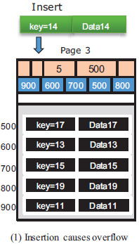
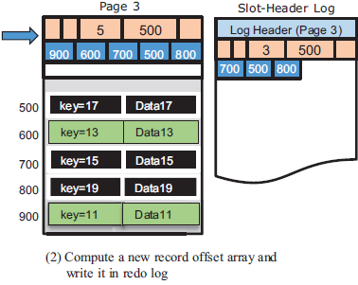
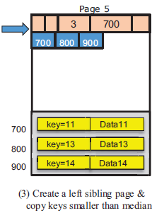
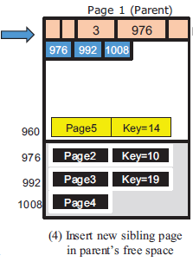
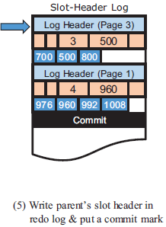
4
Implementation
Slot header logging
Ex) SQLite B-tree
Largest key
Median Key 이상 값들을 현재 Page에 유지

Slide 18
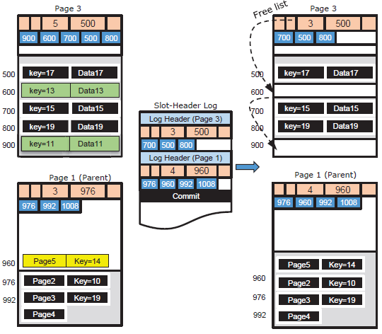
4
Implementation
Slot header logging
Ex) SQLite B-tree <Checkpointing>

Slide 19
4
Implementation
Slot header logging
Persistent Memory
Dirty Slotted
Page A
Dirty Slotted
Page B
DB Buffer Cache
Slot Header
of Page A
Slot Header
of Page B
Slot-Header Log
A
B
 |  | 2
 |  | 3
commit
Insert()
logHeader()
logHeader()
commit()
checkpoint()
Recovery
Ignore dirty records
Ignore slot-header logs
Do checkpointing

Slide 20
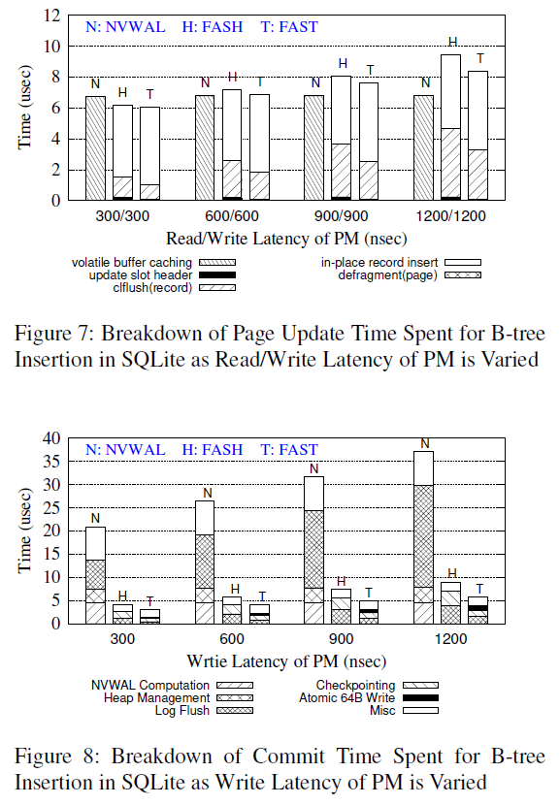
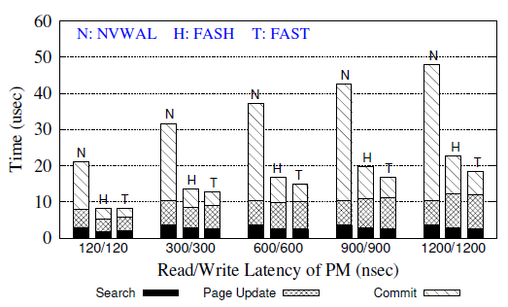
5
Experiments
Insertion time = Search + Page update + commit time
Quartz 사용 (PM emulator)
FASH : Failure-Atomic Slot-Header
FAST : Failure-Atomic Slot-header with in-place commiT
Latency 변화에 따른 B-tree single insertion time 성능 비교
Notes:
write latency는 기능을 제공하지 않고 있기 때문에, 각 clflush instruction마다 delay 추가
DRAM access latency 120nsec
Page update : NVWAL → copy-on-write overhead / FASH,FAST → overhead of flushing the updated new record
a fewer number of store instructions → in-place record insert < volatile buffer caching
clflush → To persist the new record in free space
commit time is independent of read latency of PM

Slide 21
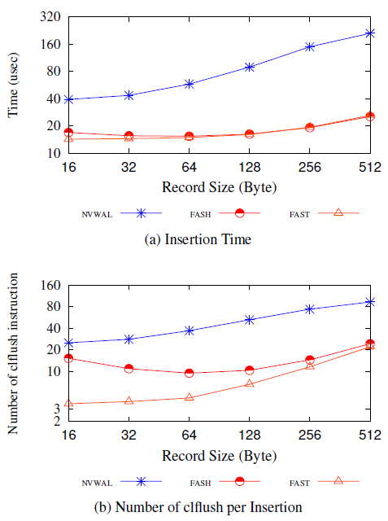
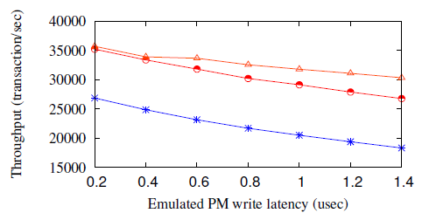
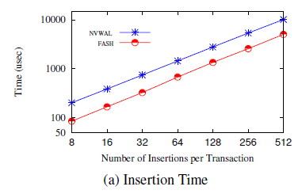
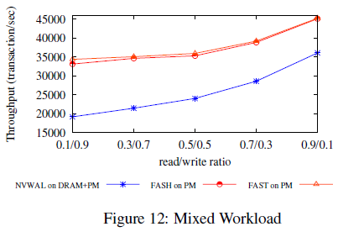
5
Experiments
Notes:
(a) Record size에 커감에 따라 → FAST, FASH는 fixed-sized slot-header 사용
(b) record size가 작으면 → slotted-page가 더 많은 record를 가지고 있을 수 있다. → Slot header 복사 수에 따른 clflush 개수 증가

Slide 22
Summary
논문의 강점
아이디어가 비교적 단순하다.
Hardware의 특성을 잘 활용하였다.
측정한 성능에 대한 결과 분석 내용이 매우 상세하다.(비교 모델 포함)
아이디어의 적용이 DBMS(SQLite) 특성을 잘 고려했다. → FAST(Single insertion) 최적
생각한 점
NVRAM 활용에서 Byte-addressable한 특징으로 인해 부분적인 Write를 수행하는 것은 기본적 + $α$
NVRAM을 적용 대상 고려 - File system, Data structure (Tree, Hashing, …), Logging, Heap manager, …
적용 대상의 적합성 고려
컴퓨터 구조와 관련한 배경 지식 활용 (CPU, instruction, Cache write policy, … )
NVRAM emulator 활용

Slide 23
Q & A

